Slide 1

Implementing security for Angular & ASP.NET Core APIs
Damien Bowden Microsoft MVP
https://damienbod.com
@damien_bod

Slide 2
Security & applications today OpenID Connect flows OpenID Implicit flow in Angular IdentityServer4 STS Server Implicit flow Resource API and ASP.NET Core Policies MVC with an Angular view and Hybrid flow Web security attacks, fixes, best practises

Slide 3




https://github.com/damienbod angular-auth-oidc-client npm ASP.NET Core, Angular

Slide 4
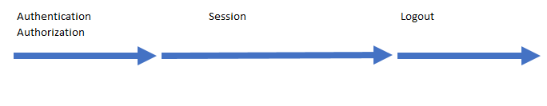

Slide 5
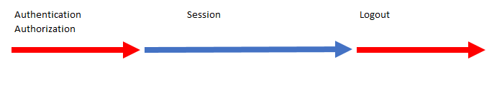

Slide 6
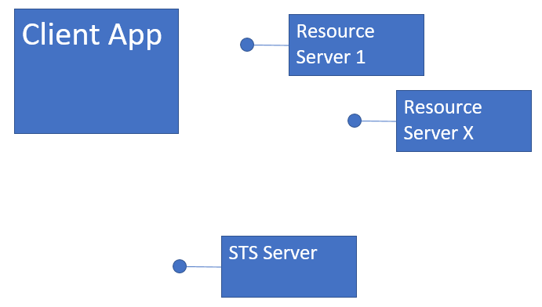


Slide 7


Slide 8

- Standard - Identity (Person can have n Identities) - Authorization (Identity and Permissions) - built on top of OAuth2 (access control)
OpenID Connect
http://openid.net/connect/

Slide 9
- Identity token - not to be used for API access
What is an “id_token” ?

Slide 10
- access token - To be used for API access, resources.
What is an “access _token” ?

Slide 11
- random string - references an access_token - easy to control the lifecycle - makes it possible that access_token must never left the safe zone
What is a “reference _token” ?

Slide 12
- Identity scopes - API or Resource scopes - managing your claims, grouping, APIs
What is a “scope” ?

Slide 13
- Implicit flow - Hybrid flow - Code flow
OpenID Connect Flows
http://openid.net/specs/openid-connect-core-1_0.html

Slide 14
- For browser applications, SPAs - Client is not authenticated - response_type=id_token token - response_type=id_token
Implicit flow
http://openid.net/specs/openid-connect-core-1_0.html#ImplicitFlowAuth

Slide 15
- Server to server applications - Client is authenticated - response_type=code
Code flow
http://openid.net/specs/openid-connect-core-1_0.html#CodeFlowAuth

Slide 16
- Mix of the Code and Implicit Flow - Can be used for Web applications with server side rendering. - response_type=code id_token
Hybrid flow
http://openid.net/specs/openid-connect-core-1_0.html#HybridFlowAuth

Slide 17
- SPAs should not handle passwords or users.
Resource Owner OAuth2

Slide 18
Taken from the OpenID specifications: “Client prepares an Authentication Request containing the desired request parameters. “ “Client sends the request to the Authorization Server. “ “Authorization Server Authenticates the End-User. “ “Authorization Server obtains End-User Consent/Authorization. “ “Authorization Server sends the End-User back to the Client with an ID Token and, if requested, an Access Token. “ “Client validates the ID token and retrieves the End-User's Subject Identifier. “
OpenID Implicit flow

Slide 19
https://localhost:44318/connect/authorize? response_type=id_token%20token& client_id=angularclient& redirect_uri=https://localhost:44311& scope=dataEventRecords%20securedFiles%20openid& nonce=N0.50564733707555191498211483602& state=14982114836020.3928729455363251
OpenID Implicit flow

Slide 20
https://localhost:44318/connect/authorize? response_type=id_token%20token& client_id=angularclient& redirect_uri=https://localhost:44311& scope=dataEventRecords%20securedFiles%20openid& nonce=N0.50564733707555191498211483602& state=14982114836020.3928729455363251
OpenID Implicit flow

Slide 21
https://localhost:44318/connect/authorize? response_type=id_token%20token& client_id=angularclient& redirect_uri=https://localhost:44311& scope=dataEventRecords%20securedFiles%20openid& nonce=N0.50564733707555191498211483602& state=14982114836020.3928729455363251
OpenID Implicit flow

Slide 22
https://localhost:44318/connect/authorize? response_type=id_token%20token& client_id=angularclient& redirect_uri=https://localhost:44311& scope=dataEventRecords%20securedFiles%20openid& nonce=N0.50564733707555191498211483602& state=14982114836020.3928729455363251
OpenID Implicit flow

Slide 23
https://localhost:44318/connect/authorize? response_type=id_token%20token& client_id=angularclient& redirect_uri=https://localhost:44311& scope=dataEventRecords%20securedFiles%20openid& nonce=N0.50564733707555191498211483602& state=14982114836020.3928729455363251
OpenID Implicit flow

Slide 24
https://localhost:44318/connect/authorize? response_type=id_token%20token& client_id=angularclient& redirect_uri=https://localhost:44311& scope=dataEventRecords%20securedFiles%20openid& nonce=N0.50564733707555191498211483602& state=14982114836020.3928729455363251
OpenID Implicit flow

Slide 25
https://localhost:44318/connect/authorize? response_type=id_token%20token& client_id=angularclient& redirect_uri=https://localhost:44311& scope=dataEventRecords%20securedFiles%20openid& nonce=N0.50564733707555191498211483602& state=14982114836020.3928729455363251
OpenID Implicit flow

Slide 26
- Code
OpenID Implicit flow

Slide 27
- Code
IdentityServer4 STS Server Implicit flow

Slide 28
- Code
Resource API and ASP.NET Core Policies

Slide 29
- Using cookies with Angular - Anti forgery cookies a MUST
MVC with an Angular view and Hybrid flow

Slide 30
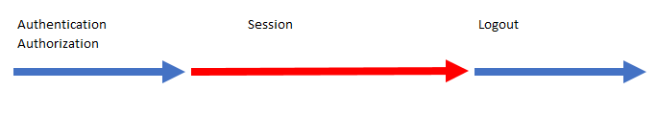

Slide 31
- Never allow the “access_token” in the URL
Downloading secure files

Slide 32
Persistent XSS, where the malicious string originates from the website's database. Reflected XSS, where the malicious string originates from the victim's request. DOM-based XSS, where the vulnerability is in the client-side code rather than the server-side code. src: https://excess-xss.com/ # Same Origin Policy (active per default), set CORS for your website # X-XSS-Protection (Http Header) # Use Content Security Policy (prevents inline code) # HTML output avoid if possible, or HTML encode
Cross Site Scripting XSS

Slide 33
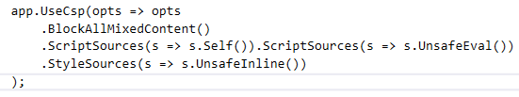
content-security-policy: default-src 'self’ content-security-policy: script-src 'self' 'unsafe-eval';style-src 'unsafe-inline';block-all-mixed-content
CSP Content Security Policy

Slide 34
Access-Control-Allow-Origin: http://foo.example Access-Control-Allow-Methods: POST, GET, OPTIONS Access-Control-Allow-Headers: X-PINGOTHER, Content-Type Access-Control-Max-Age: 86400 https://docs.microsoft.com/en-us/aspnet/core/security/cors
CORS Cross-Origin Resource Sharing

Slide 35
- Attacker gets the users identity - A bigger problem when using cookies
Cross-Site Request Forgery (CSRF)

Slide 36
# HTTPS, encryption # HSTS (HTTP Strict Transport Security ) # Strict-Transport-Security: max-age=33333333 (browser internal redirects) https_//hstpreload.appspot.com app.UseHsts(o = o.MaxAge(days:365).Preload()
Sensitive Data Exposure

Slide 37
- Man in the middle attack [RequireHttps] Startup - o => o.Filters.Add(new RequireHttpsAttribute())
Force SSL

Slide 38
- SPA problems with Cookies # use tokens
Session hijacking

Slide 39
IsLocalRedirect(), only allows relative urls
Open redirect Attack

Slide 40
- admin, non authorization, extra properties in DTO
Access control to data & functions

Slide 41
# links should always include: rel="noopener noferrer"
Phishing

Slide 42
Why ?
Underprotected APIs

Slide 43
# Limit by scheme (ActiveAuthenicationSchemes = "Bearer")
Don't mix cookies and tokens in one APIs

Slide 44

Use secure cookies only ! Use HTTP only cookies !

Slide 45
Thank you @damienbod

Slide 46
https://github.com/damienbod/AspNet5IdentityServerAngularImplicitFlow https://www.npmjs.com/package/angular-auth-oidc-client http://openid.net https://auth0.com/blog/cookies-vs-tokens-definitive-guide https://www.npmjs.com/package/angular-auth-oidc-client https://github.com/IdentityModel/oidc-client-js

